Slide 1
ESG-FINANCIAL ANALYSIS
By Felicitas Ezechikeluba

Slide 2
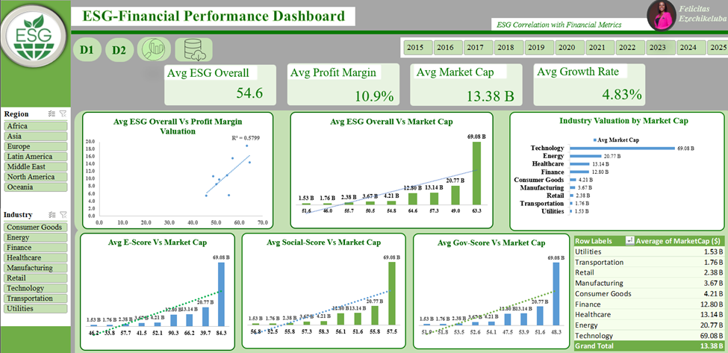
DASHBOARDS

Slide 3
OVERVIEW
This project explores the relationship between Environmental, Social, and Governance (ESG) scores and key financial metrics across 1,000 publicly traded companies globally (2015–2025). It aims to uncover patterns to guide investors toward sustainable and high-performing companies by industry and region.

Slide 4
PROJECT BACKGROUND
What is ESG?
A framework for evaluating a company’s long-term sustainability and ethical impact beyond financial metrics.
E – Environmental
How a company manages its impact on nature — e.g., emissions, energy use, waste.
S – Social
How a company treats people — employees, customers, communities, and suppliers.
G – Governance
How a company is run — leadership ethics, board structure, transparency, compliance.
It Used by investors, consumers, and regulators to assess responsibility and future performance.

Slide 5
PROJECT BACKGROUND
Why ESG Matters
Investors rely on ESG scores to identify sustainable, lower-risk investment opportunities and Industries.
Stakeholders view strong ESG performance as an indicator of long-term value, ethical governance, and social responsibility.
While ESG data is widely available, its direct link to financial performance is often unclear or underutilized. Investors and stakeholders need a clearer understanding of:
Which ESG pillars (Environmental, Social, Governance) drive the most value.
Which industries or regions lead or lag in ESG performance.
Whether high ESG scores translate into strong financial outcomes.

Slide 6
PROBLEM STATEMENT
Do companies with higher ESG scores perform better and have more market value across industries?

Slide 7
GOALS AND OBJECTIVES
GOALS
To determine how ESG metrics influence company profitability and investor perception across industries and regions
PROJECT OBJECTIVES
This project focuses on the financial relevance of ESG data, especially in guiding sustainable investments across industries and regions, and it will clearly define how ESG factors relate to company financials. This includes:
∙ Identifying high- and low-performing companies from an ESG perspective.
∙ Investigating which ESG pillars (Environmental, Social, Governance) most strongly correlate with financial success.
∙ Recognizing industry or regional patterns in ESG scores and performance metrics

Slide 8
BUSINESS QUESTIONS
This analysis will focus on answering the following 5 key questions:
1. What is the correlation between overall ESG scores and financial metrics like profit margin and market cap?
2. Which ESG factor most strongly influences industry valuation?
3. What are the Top 3 Valuable Industries?
4. Which industries combine high ESG and strong performance?
5. Which regions show the best blend of ESG and financial strength?

Slide 9
Correlation Analysis
 | Average of ESG_Overall (0-100 Scale) | Average of Profit Margin
Average of ESG_Overall (0-100 Scale) | 1
Average of ProfitMargin | 0.761497798 | 1
 | Average of ESG_Overall (0-100 Scale) | Average of MarketCap ($)
Average of ESG_Overall (0-100 Scale) | 1
Average of MarketCap ($) | 0.552759589 | 1
INTERPRETATION:
ESG Overall vs. Profit Margin & Market Cap
• Profit Margin: 0.76 (Strong positive relationship)
→ Companies with higher overall ESG scores tend to have higher profit margins.
• Market Cap: 0.55 (Moderate positive relationship)
→ Companies with higher overall ESG scores tend to be larger in market value.

Slide 10
Correlation Analysis
 | Average of ESG_Environmental (0-100 Scale) | Average of Profit Margin
Average of ESG_Environmental (0-100 Scale) | 1
Average of ProfitMargin | 0.772343019 | 1
 | Average of ESG_Environmental (0-100 Scale) | Average of MarketCap ($)
Average of ESG_Environmental (0-100 Scale) | 1
Average of MarketCap ($) | 0.571034143 | 1
INTERPRETATION :
Strong positive correlation. Companies with better environmental practices tend to be more profitable
Moderate positive correlation. Companies with stronger environmental scores generally have larger market valuations, but less strongly than profit margin.

Slide 11
Correlation Analysis
 | Average of ESG_Social (0-100 Scale) | Average of Profit Margin
Average of ESG_Social (0-100 Scale) | 1
Average of ProfitMargin | 0.103700067 | 1
 | Average of ESG_Social (0-100 Scale) | Average of MarketCap ($)
Average of ESG_Social (0-100 Scale) | 1
Average of MarketCap ($) | 0.215155556 | 1
INTERPRETATION :
Profit Margin: (0.103700067) Very weak positive correlation. Social practices do not strongly affect profitability across the companies.
Weak positive correlation (0.215155556). Companies with better social practices have slightly larger market caps, but the link is weak.

Slide 12
Correlation Analysis
 | Average of ESG_Governance (0-100 Scale) | Average of ProfitMargin
Average of ESG_Governance (0-100 Scale) | 1
Average of ProfitMargin | -0.521206535 | 1
 | Average of ESG_Governance (0-100 Scale) | Average of MarketCap ($)
Average of ESG_Governance (0-100 Scale) | 1
Average of MarketCap ($) | -0.600520445 | 1
Moderate negative correlation. This means that, as governance scores increase, profit margins tend to decrease, across the companies/industries.
Moderately strong negative correlation. This indicates that companies with higher governance scores tend to have lower market capitalizations.

Slide 13
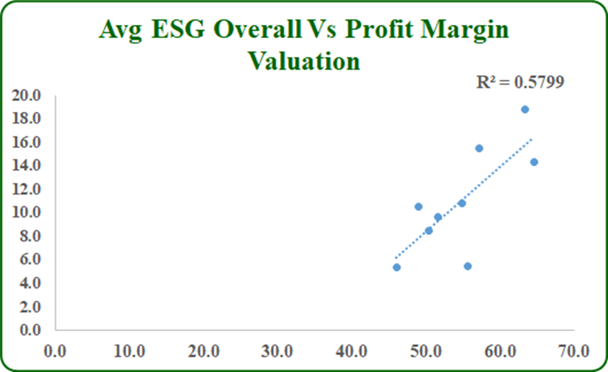
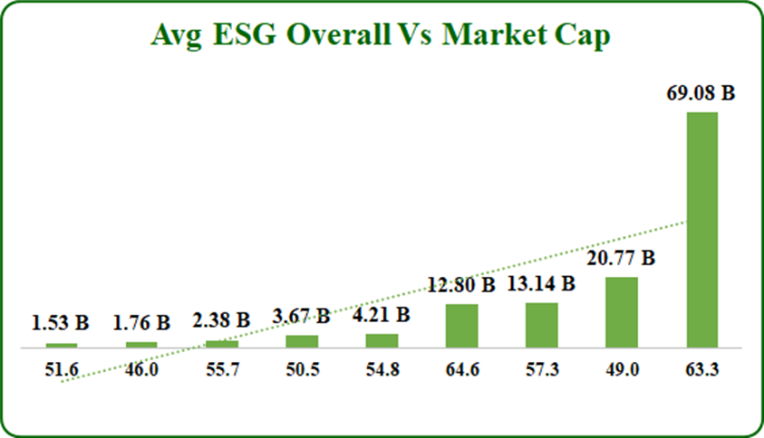
ANALYSIS AND FINDINGS
1. What is the correlation between overall ESG scores and financial metrics like profit margin and market cap?
Industries with stronger overall ESG scores generally show better financial health. There’s a strong positive relationship between ESG scores and profit margins across industries, suggesting that sustainable practices often go together with profitability.
Additionally, there's a moderate positive correlation between ESG scores and market capitalization, indicating that larger, more established industries tend to invest more in ESG performance. This highlights ESG as both a financial and reputational asset.

Slide 14
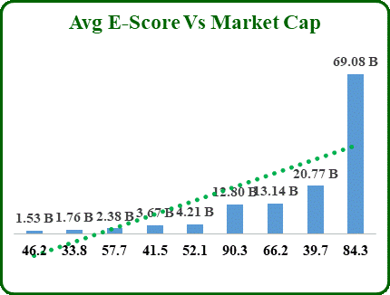
ANALYSIS AND FINDINGS
2. Which ESG factor most strongly influences industry valuation?
Industries with strong environmental scores tend to be more profitable and larger in size. The very strong positive correlation with profit margin of 0.7 suggests that investing in environmental sustainability (like energy efficiency or waste reduction) can directly support profitability.
The moderate link with market cap shows that bigger and top industries are more likely to prioritize environmental performance.

Slide 15
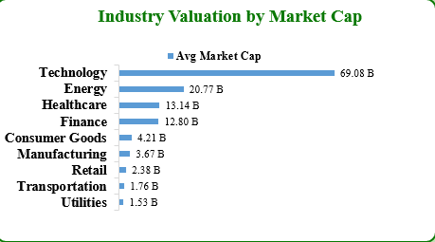
ANALYSIS AND FINDINGS
3. What are the Top 3 Valuable Industries?
The data shows that Technology – 69.08, Energy – 20.77 B & Healthcare – 13.14 B are the most valuable industries by the measure of their market cap in dollars

Slide 16
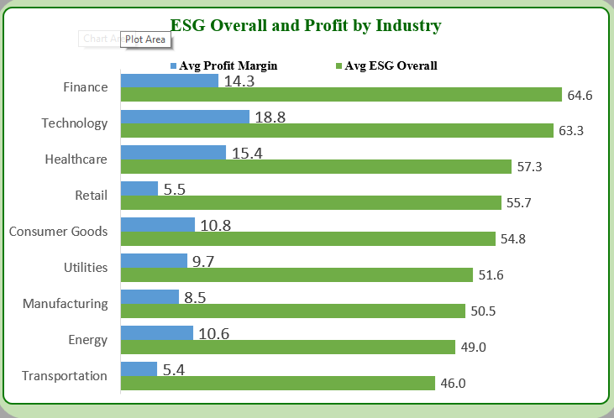
ANALYSIS AND FINDINGS
4. Which industries combine high ESG and strong performance?
Technology, Finance, and Healthcare are the best at merging sustainability with profitability. Industries in these sectors prove ESG doesn’t require sacrificing margins.
1. Technology
ESG: 63.3 (2nd highest)
Profit Margin: 18.8% (highest)
2. Finance
ESG: 64.6 (highest)
Profit Margin: 14.3% (3rd highest)
3. Healthcare
ESG: 57.3
Profit Margin: 15.4% (2nd highest)

Slide 17
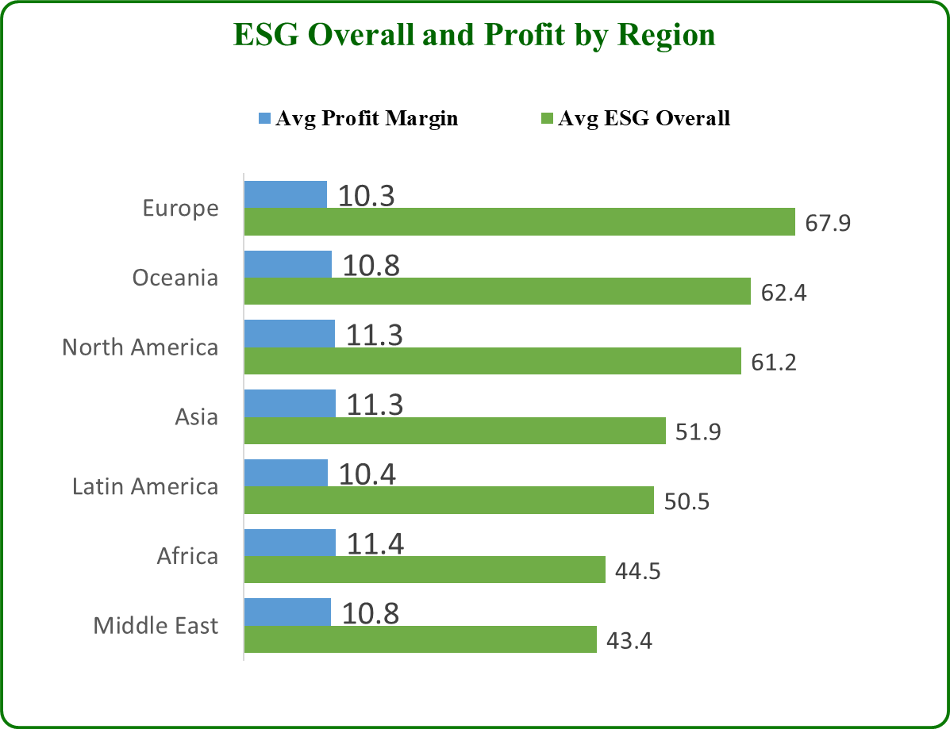
ANALYSIS AND FINDINGS
5. Which regions show the best blend of ESG and financial strength?
From the data, the top-performing regions that combine high ESG scores with competitive profit margins are:
1. Europe
ESG: 67.9 (highest globally)
Profit Margin: 10.3% (moderate but stable)
2. Oceania
ESG: 62.4 (2nd highest)
Profit Margin: 10.8% (above Europe)
3. North America
ESG: 61.2
Profit Margin: 11.3% (highest among top ESG regions)
Insight: These findings suggest that developed regions are not only leading in sustainability but are also succeeding financially, showing that responsible business practices can enhance, and not hinder profitability.

Slide 18
RECOMMENDATIONS
For Businesses:
  Invest in ESG areas that boost performance, especially environmental practices like energy efficiency and emissions reduction.
  Avoid over-spending on governance if it reduces profits without clear returns keep governance efficient and compliant.
  Balance ESG efforts across all three pillars (E, S, G) for long-term sustainability and trust.
  2. For Investors:
  Target industries and regions with strong ESG and financial performance especially tech and finance sectors in Europe and North America.
  Avoid low-ESG sectors (e.g., coal or heavy extractives), which face higher long-term regulatory and reputational risks.
  Use ESG scores (especially Environmental) as a reliable filter when selecting investment opportunities.

Slide 19
CONCLUSION
ESG isn’t a profit-killer, companies and industries with higher ESG scores tend to perform better and have greater market value, but it’s not universal.
It also depends on industry, region, business model, region and strategy.
The best approach: balance sustainability with financial goals, using top performers (tech, Europe) as benchmarks.

